Slide 1
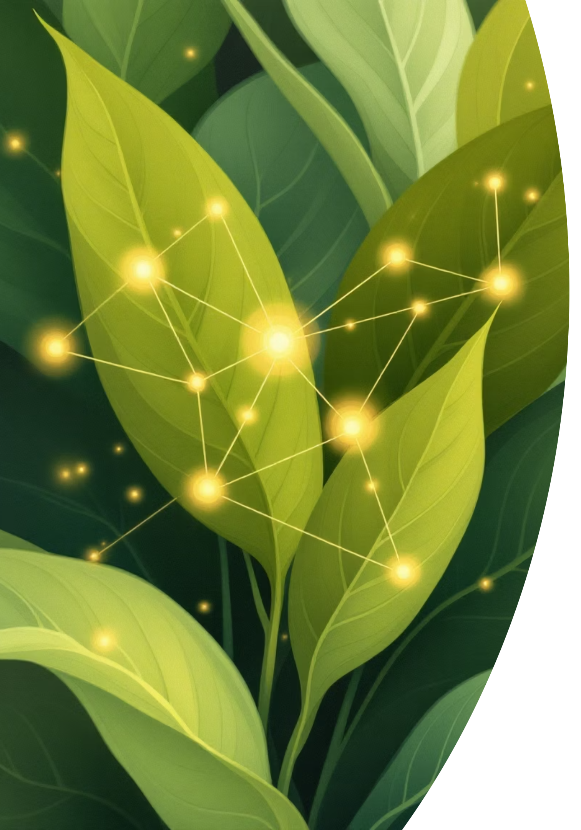
Plant Disease Detection Using AI
An Intelligent System for Early Disease Identification & Treatment Recommendations
Presented by: [Your Name/Team Name] | [Date]

Slide 2
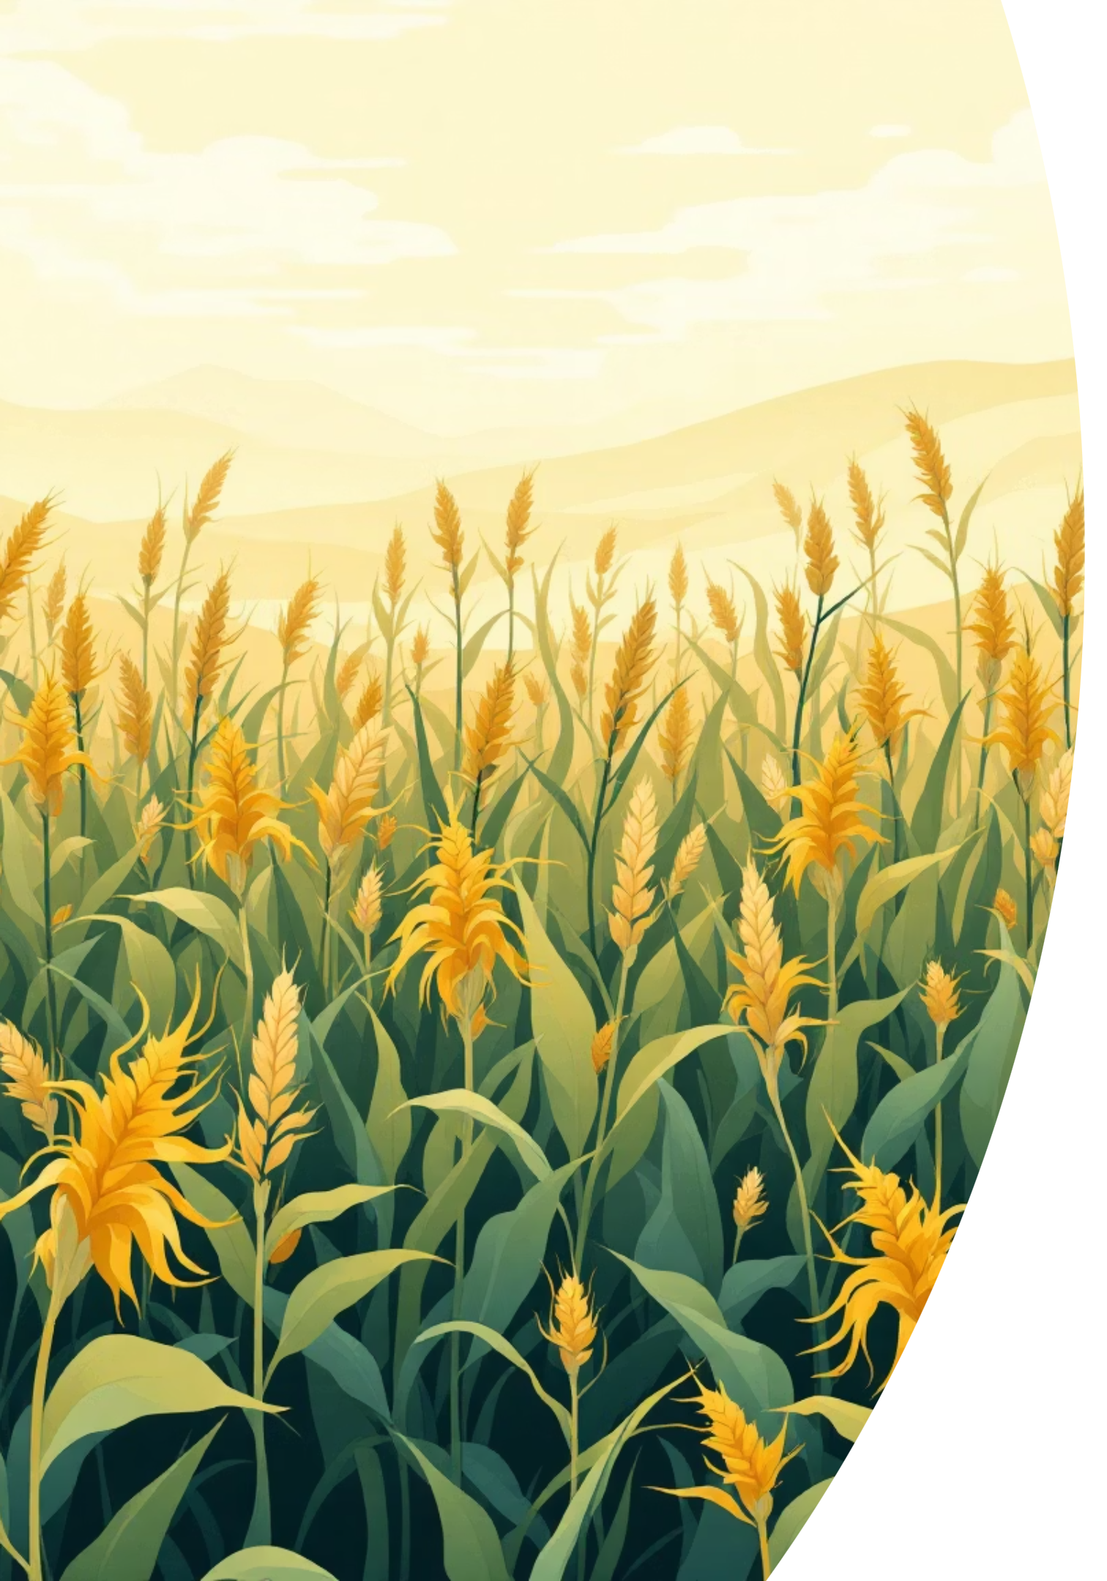

The Silent Threat: Global Crop Loss
Massive Losses
An alarming 40% of global crop yield is lost annually due to devastating plant diseases, threatening food security worldwide.
Late Detection
Current methods often lead to late disease detection, allowing pathogens to spread rapidly and cause widespread crop damage before intervention.
Access Gap
Many farmers, especially in remote rural areas, lack access to expert diagnosis and timely agricultural advice.
Slow & Complex
Traditional identification relies on visual inspection, which is time-consuming, subjective, and requires specialized botanical knowledge.

Slide 3
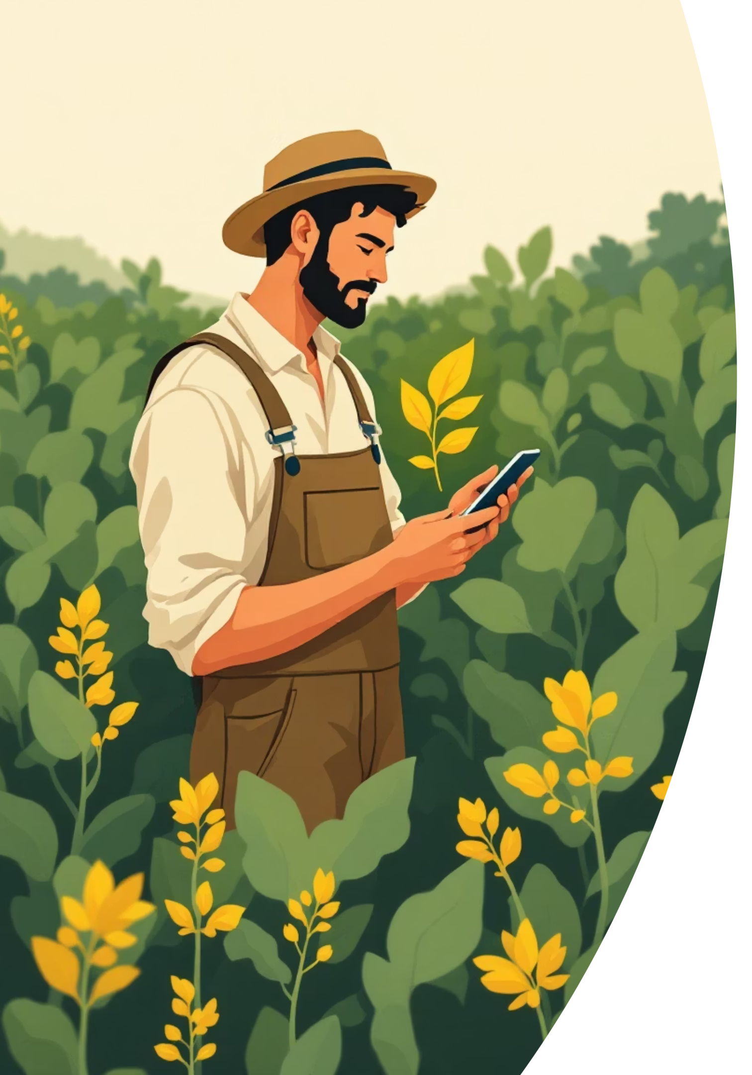
Introducing Our AI-Powered Solution
Empowering farmers and researchers with immediate, accurate plant health insights.
Instant Diagnosis
Simply upload a leaf image and receive an immediate disease diagnosis with remarkable precision.
Confidence Scoring
Each prediction comes with a confidence score, ensuring transparency and aiding in decision-making.
Treatment Guidance
Get comprehensive, actionable treatment recommendations tailored to the identified disease.
Universal Accessibility
Our platform is designed to be easily accessible to farmers, students, and agricultural researchers alike.

Slide 4

Core Functionality: How It Works
01
Effortless Image Upload
Seamlessly drag & drop or click to upload high-resolution leaf photos in JPG or PNG format. Our system is designed for ease of use.
02
Advanced AI Analysis
A powerful Convolutional Neural Network (CNN) algorithm rapidly analyzes visual patterns on the leaf to identify potential diseases.
03
Precise Disease Identification
Receive a clear diagnosis including the plant name, specific disease type, and a confidence percentage for the prediction.
04
Actionable Treatment Guide
Access detailed, practical treatment recommendations, including organic and chemical solutions, alongside crucial prevention tips.

Slide 5
Robust Technology Stack
Built with modern, scalable technologies for peak performance and user experience.
Frontend
React, TypeScript, Tailwind CSS - For a dynamic, type-safe, and visually appealing user interface.
UI Components
Shadcn/UI, Lucide Icons - Delivering elegant, accessible, and highly customizable UI elements.
AI Model
CNN Classifier - Trained extensively on the comprehensive PlantVillage Dataset for accuracy.
Build Tool
Vite - Ensuring blazing-fast development and optimized build performance.

Slide 6


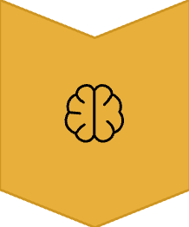
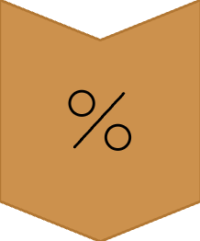


System Architecture: A Seamless Flow
From image capture to diagnosis, our system processes data efficiently.
User Uploads Image
A farmer captures or uploads a picture of a diseased leaf.
Preprocessing & Validation
The image undergoes resizing, normalization, and quality checks.
AI Model Analysis
Our CNN model analyzes visual patterns to identify disease characteristics.
Classification & Score
The system classifies the disease and provides a confidence percentage.
Treatment Lookup
Relevant treatment recommendations are retrieved from our extensive database.
Results Displayed
The user receives a comprehensive report on their device.

Slide 7
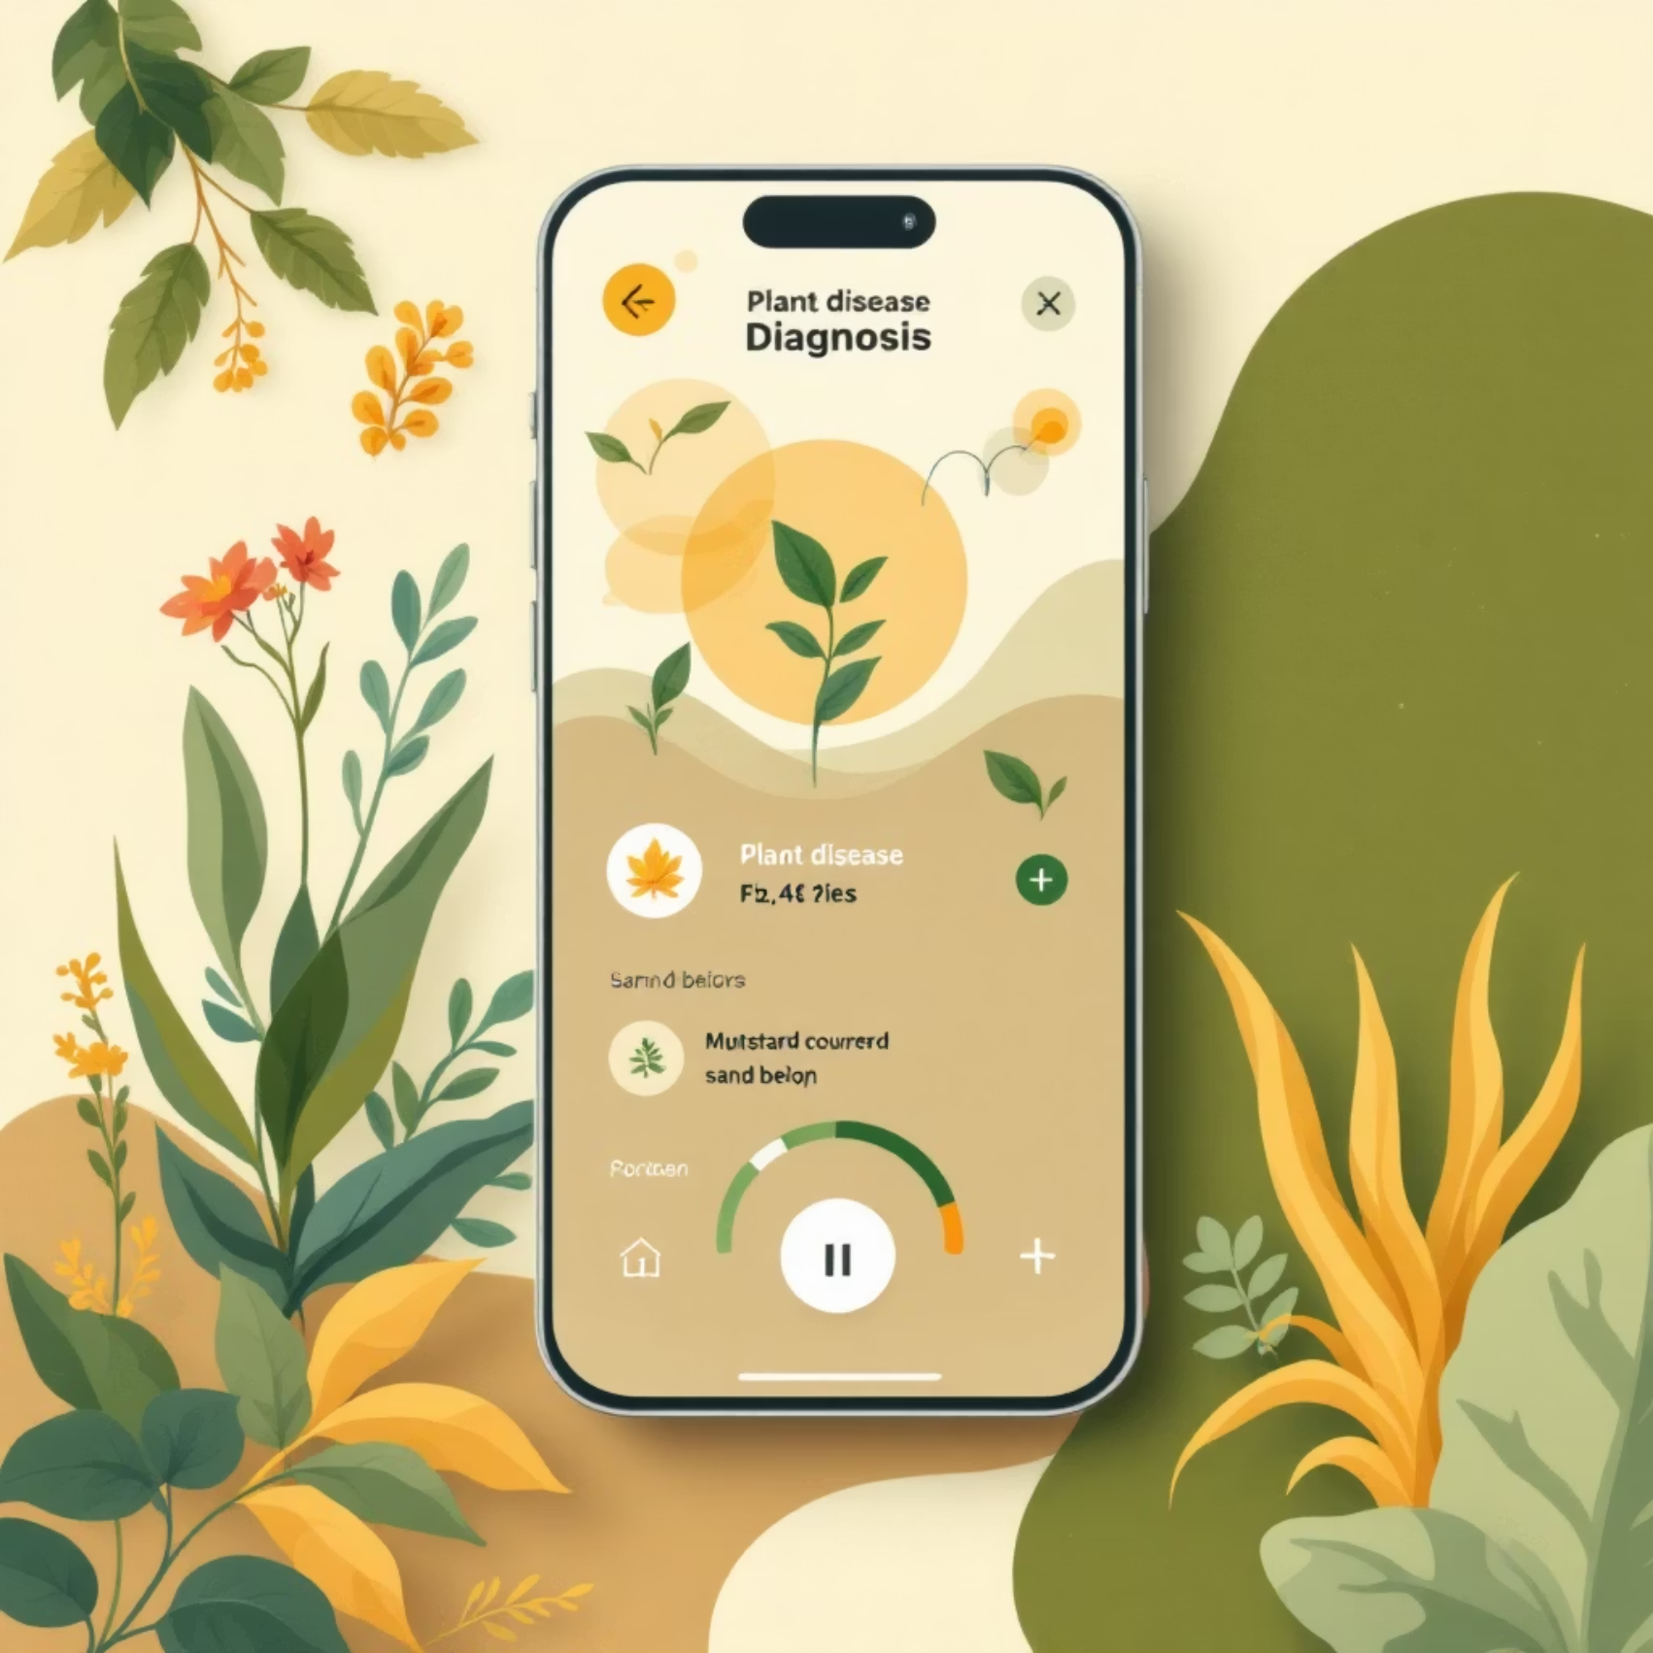
Intuitive User Interface Design
Designed for simplicity and clarity, ensuring a positive user experience for all.
Mobile-Responsive: Optimized for seamless use across all devices, from smartphones to tablets.
Drag-and-Drop Upload: Effortless image submission with real-time preview functionality.
Loading Indicators: Clear visual feedback ensures users are always informed of process status.
Color-Coded Results: Instantly differentiate between healthy (green) and diseased (amber) plant states.
Expandable Sections: Treatment recommendations are neatly organized and expandable for detailed viewing.

Slide 8
Comprehensive Disease Detection Capabilities
Our AI model is trained to recognize a wide array of common plant afflictions.
Early Blight
Commonly affecting Tomato and Potato plants, characterized by dark concentric spots on leaves.
Late Blight
A devastating disease for Tomato and Potato, causing rapid tissue decay and wilting.
Leaf Spot
A broad category of fungal or bacterial diseases creating small, discolored spots on various crops.
Powdery Mildew
Recognizable by white, powdery patches on the surface of leaves and stems across multiple species.
Healthy Plant Detection
Our system can also confirm a healthy plant, providing peace of mind and allowing for proactive care.

Slide 9





Future Enhancements: Our Roadmap
Continuously evolving to meet the growing needs of the agricultural community.
Camera Capture
Direct image capture functionality for mobile devices, enhancing user convenience in the field.
Scan History & Reports
Personalized scan history, allowing users to track progress, and generate downloadable PDF reports.
Multi-Language Support
Expanding accessibility by supporting multiple languages, catering to a global user base.
Real-time AI Integration
Implementing real-time AI model updates and continuous learning for ever-improving accuracy.
Analytics Dashboard
A dedicated dashboard for researchers to access aggregated data and gain deeper insights into disease patterns.

Slide 10
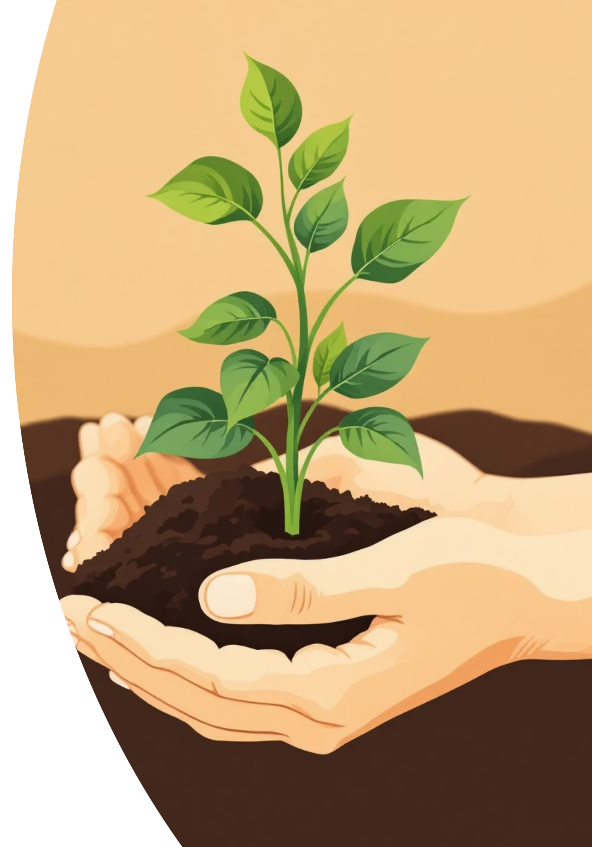
Impact & Benefits: Cultivating a Healthier Future
Early Detection Saves Crops
Timely identification prevents widespread damage, significantly reducing crop losses and safeguarding farmer livelihoods.
Accessible to Non-Experts
Our intuitive design empowers anyone, regardless of agricultural background, to diagnose plant diseases effectively.
Reduces Dependency
Less reliance on costly and often unavailable agricultural consultants, putting diagnostic power directly into farmers' hands.
Promotes Sustainable Farming
By enabling targeted treatments, we help minimize pesticide use and encourage environmentally friendly practices.
Thank You!

